Slide 1

Session 08
Abstract classes and Interfaces

Slide 2
Objectives
Define and describe abstract classes
Explain interfaces
Compare abstract classes and interfaces

Slide 3
Abstract Classes
C# allows designing a class specifically to be used as a base class by declaring it an abstract class.
Such class can be referred to as an incomplete base class, as it cannot be instantiated, but it can only be implemented or derived.
An abstract class is declared using the abstract keyword which may or may not contain one or more of the following:
normal data member(s)
normal method(s)
abstract method(s)

Slide 4
Purpose 1-2
Consider the base class, Animal, that defines methods such as Eat(), Habitat(), and AnimalSound().
The Animal class is inherited by different subclasses such as Dog, Cat, Lion, and Tiger.
The dogs, cats, lions, and tigers neither share the same food, habitat nor do they make similar sounds.
Hence, the Eat(), Habitat(), and AnimalSound() methods need to be different for different animals even though they inherit the same base class.
These differences can be incorporated using abstract classes.

Slide 5
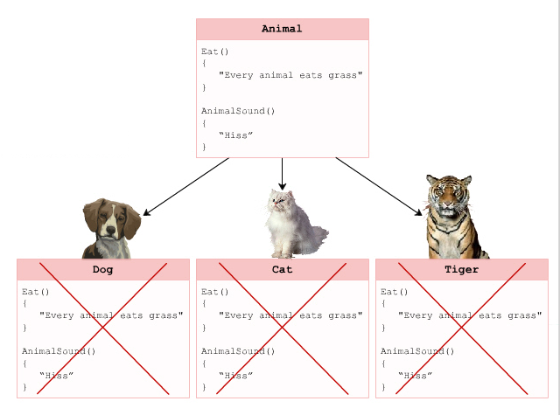
Purpose 2-2
The following figure displays an example of abstract class and subclasses:

Slide 6
Definition 1-4
An abstract class can implement methods that are similar for all the subclasses.
A class that is defined using the abstract keyword and that contains at least one method which is not implemented in the class itself is referred to as an abstract class.
In the absence of the abstract keyword, the class will not be compiled.
Since the abstract class contains at least one method without a body, the class cannot be instantiated using the new keyword.

Slide 7
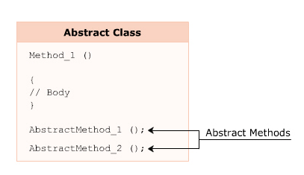
Definition 2-4
The following figure displays the contents of an abstract class:

Slide 8
Definition 3-4
The following syntax is used for declaring an abstract class:
where,
abstract: Specifies that the declared class is abstract.
ClassName: Specifies the name of the class.
Syntax
public abstract class <ClassName> {
<access_modifier> abstract <return_type> <MethodName>(argument_list);
}

Slide 9
Definition 4-4
The following code declares an abstract class Animal:
In the code:
The abstract class Animal is created using the abstract keyword.
The Animal class implements the non-abstract method, Eat(), as well as declares two abstract methods, AnimalSound() and Habitat().
Snippet
public abstract class Animal {
//Non-abstract method implementation public void Eat()
{
Console.WriteLine(“Every animal eats food in order to
survive”);
}
//Abstract method declaration
public abstract void AnimalSound(); public abstract void Habitat();
}

Slide 10
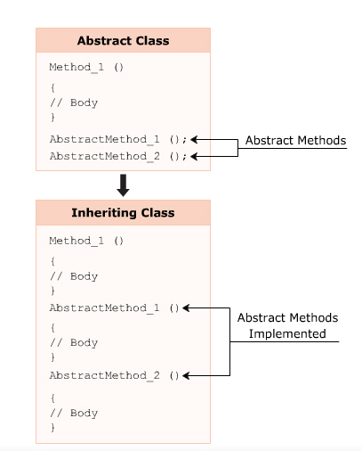
Implementation 1-4
The subclass inheriting the abstract class has to override and implement the abstract methods with the same name and arguments.
On failing to implement, the subclass cannot be instantiated as the C# compiler considers it as abstract.
The following figure displays an example of inheriting an abstract class:

Slide 11
Implementation 2-4
The following syntax is used to implement an abstract class:
where,
AbstractClassName: Specifies the name of the inherited abstract class.
Syntax
class <ClassName> : <AbstractClassName> {
// class members;
}

Slide 12
Implementation 3-4
The following code declares and implements an abstract class:
Snippet
abstract class Animal {
public void Eat() {
Console.WriteLine(“Every animal eats food in order to survive”);
}
public abstract void AnimalSound();
}
class Lion : Animal
{
public override void AnimalSound() {
Console.WriteLine(“Lion roars”);
}
static void Main(string[] args) {
Lion objLion = new Lion(); objLion.AnimalSound(); objLion.Eat();
}
}

Slide 13
Implementation 4-4
Lion roars
Every animal eats food in order to survive
In the code:
The abstract class Animal is declared, and the class Lion inherits the abstract class Animal.
Since the Animal class declares an abstract method called AnimalSound(), the Lion class overrides the method AnimalSound() using the override keyword and implements it.
The Main()method of the Lion class then invokes the methods AnimalSound()and Eat() using the dot(.) operator.
Output

Slide 14
Implement Abstract Base Class Using IntelliSense 1-2
IntelliSense provides access to member variables, functions, and methods of an object or a class. Thus, it helps the programmer to easily develop the software by reducing the amount of input typed in, since IntelliSense performs the required typing. IntelliSense can be used to implement system-defined abstract classes.
The steps performed to implement an abstract class using IntelliSense are as follows:
Place Cursor
Place the cursor after the class IntelliSenseDemo statement.
Type the following : TimeZone
The class declaration becomes class IntelliSenseDemo : TimeZone.
Click Smart Tag
Click the smart tag that appears below the TimeZone class.
Click Implement abstract class System.TimeZone
IntelliSense provides four override methods from the system-defined TimeZone class to the user-defined IntelliSenseDemo class.

Slide 15
Implement Abstract Base Class Using IntelliSense 2-2
The following code demonstrates the way the methods of the abstract class TimeZone are invoked automatically by IntelliSense:
Snippet
using System;
class IntelliSenseDemo : TimeZone {
public override string DaylightName {
get { throw new Exception("The method or operation is not implemented."); }
}
public override System.Globalization.DaylightTime GetDaylightChanges (int year)
{
throw new Exception("The method or operation is not implemented.");
}
public override TimeSpan GetUtcOffset(DateTime time) {
throw new Exception("The method or operation is not implemented.");
}
public override string StandardName {
get { throw new Exception("The method or operation is not implemented."); }
}
}

Slide 16
Abstract Methods 1-2
The methods in the abstract class that are declared without a body are termed as abstract methods.
Following are the features of the abstract methods:
These methods are implemented in the inheriting class.
They are declared with an access modifier, a return type, and a signature.
They do not have a body and the method declaration ends with a semicolon.
They provide a common functionality for the classes inheriting the abstract class. The subclasses of the abstract class can override and implement the abstract methods.

Slide 17
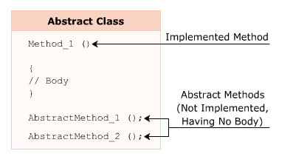
Abstract Methods 2-2
The following figure displays an example of abstract methods:

Slide 18
Multiple Inheritance through Interfaces
A subclass in C# cannot inherit two or more base classes because C# does not support multiple inheritance.
To overcome this drawback, interfaces were introduced.
A class in C# can implement multiple interfaces.

Slide 19
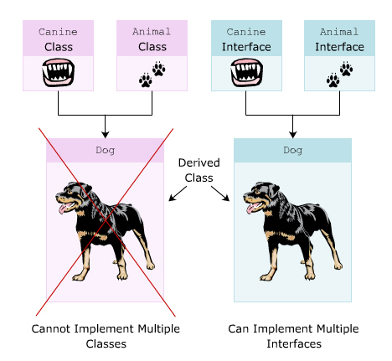
Purpose of Interfaces
Consider a class Dog that needs to inherit features of Canine and Animal classes.
The Dog class cannot inherit methods of both these classes as C# does not support multiple inheritance.
However, if Canine and Animal are declared as interfaces, the class Dog can implement methods from both the interfaces.
The following figure displays an example of subclasses with interfaces in C#:

Slide 20
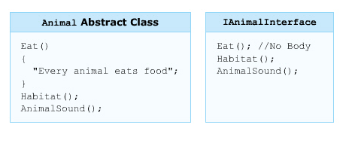
Interfaces 1-2
An interface contains only abstract members that cannot implement any method.
An interface cannot be instantiated but can only be inherited by classes or other interfaces.
An interface is declared using the keyword interface.
In C#, by default, all members declared in an interface have public as the access modifier.
The following figure displays an example of an interface:

Slide 21
Interfaces 2-2
The following syntax is used to declare an interface:
where,
interface: Declares an interface.
InterfaceName: Is the name of the interface.
The following code declares an interface IAnimal:
In the code:
The interface IAnimal is declared which contains an abstract method AnimalType().
Syntax
interface <InterfaceName>
{
//interface members
}
Snippet
interface IAnimal
{
void AnimalType();
}

Slide 22
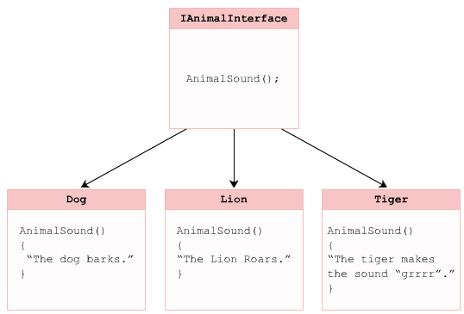
Implementing an Interface 1-4
An interface is implemented by a class in a way similar to inheriting a class.
When implementing an interface in a class, implement all the abstract methods declared in the interface. If all the methods are not implemented, the class cannot be compiled.
The methods implemented in the class should be declared with the same name and signature as defined in the interface.
The following figure displays the implementation of an interface:

Slide 23
Implementing an Interface 2-4
The following syntax is used to implement an interface:
where,
InterfaceName: Specifies the name of the interface.
Syntax
class <ClassName> : <InterfaceName>
{
//Implement the interface methods.
//Define class members.
}

Slide 24
Implementing an Interface 3-4
The following code declares an interface IAnimal and implements it in the class Dog:
Dog
Can be housed with human beings
Snippet
interface IAnimal
{
void Habitat();
}
class Dog : IAnimal
{
public void Habitat()
{
Console.WriteLine(“Can be housed with human beings”);
}
static void Main(string[] args)
{
Dog objDog = new Dog();
Console.WriteLine(objDog.GetType().Name);
objDog.Habitat();
}
}
Output

Slide 25
Implementing an Interface 4-4
In the code:
The code creates an interface IAnimal that declares the method Habitat().
The class Dog implements the interface IAnimal and its method Habitat().
In the Main() method of the Dog class, the class name is displayed using the object and then, the method Habitat()is invoked using the instance of the Dog class.

Slide 26
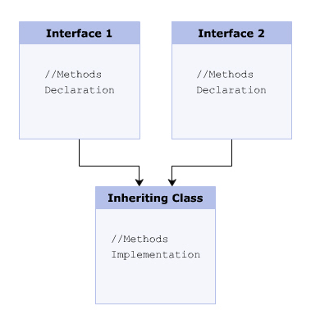
Interfaces and Multiple Inheritance 1-3
Multiple interfaces can be implemented in a single class which provides the functionality of multiple inheritance.
You can implement multiple interfaces by placing commas between the interface names while implementing them in a class.
A class implementing multiple interfaces has to implement all abstract methods declared in the interfaces.
The override keyword is not used while implementing abstract methods of an interface.
The following figure displays the concept of multiple inheritance using interfaces:

Slide 27
Interfaces and Multiple Inheritance 2-3
The following syntax is used to implement multiple interfaces:
where,
Interface1: Specifies the name of the first interface.
Interface2: Specifies the name of the second interface.
Syntax
class <ClassName> : <Interface1>, <Interface2>
{
//Implement the interface methods
}

Slide 28
Interfaces and Multiple Inheritance 3-3
The following code declares and implements multiple interfaces:
The Crocodile eats flesh
The Crocodile can swim four times faster than an Olympic swimmer
Snippet
interface ITerrestrialAnimal
{
void Eat();
}
interface IMarineAnimal
{
void Swim();
}
class Crocodile : ITerrestrialAnimal, IMarineAnimal
{
public void Eat()
{
Console.WriteLine(“The Crocodile eats flesh”);
}
public void Swim()
{
Console.WriteLine(“The Crocodile can swim four times faster than an Olympic swimmer”);
}
static void Main(string[] args)
{
Crocodile objCrocodile = new Crocodile();
objCrocodile.Eat();
objCrocodile.Swim();
}
}
Output

Slide 29
Explicit Interface Implementation 1-5
A class has to explicitly implement multiple interfaces if these interfaces have methods with identical names.
If an interface has a method name identical to the name of a method declared in the inheriting class, this interface has to be explicitly implemented.
Consider the interfaces ITerrestrialAnimal and IMarineAnimal. The interface ITerrestrialAnimal declares methods Eat() and Habitat().
The interface IMarineAnimal declares methods Eat()and Swim().
The class Crocodile implementing the two interfaces has to explicitly implement the method Eat() from both interfaces by specifying the interface name before the method name.
While explicitly implementing an interface, you cannot mention modifiers such as abstract, virtual, override, or new.
Example

Slide 30
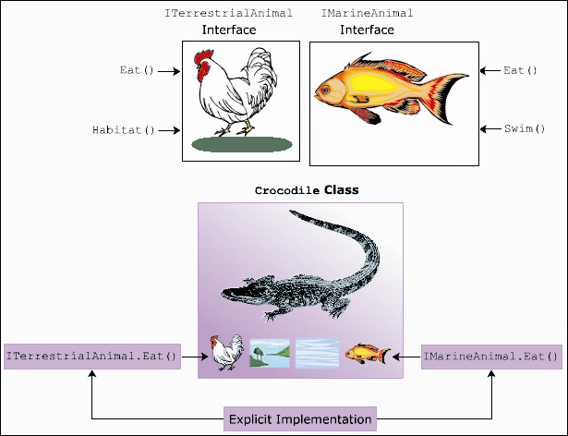
Explicit Interface Implementation 2-5
The following figure displays the explicit implementation of interfaces:

Slide 31
Explicit Interface Implementation 3-5
The following syntax is used to explicitly implement interfaces:
where,
Interface1: Specifies the first interface implemented.
Interface2: Specifies the second interface implemented.
Method(): Specifies the same method name declared in the two interfaces.
Syntax
class <ClassName> : <Interface1>, <Interface2>
{
<access modifier> Interface1.Method();
{
//statements;
}
<access modifier> Interface2.Method();
{
//statements;
}
}

Slide 32
Explicit Interface Implementation 4-5
The following code demonstrates the use of implementing interfaces explicitly:
Snippet
interface ITerrestrialAnimal
{
string Eat();
}
interface IMarineAnimal
{
string Eat();
}
class Crocodile : ITerrestrialAnimal, IMarineAnimal
{
string ITerrestrialAnimal.Eat()
{
string terCroc = “Crocodile eats other animals”;
return terCroc;
}
string IMarineAnimal.Eat()
{
string marCroc = “Crocodile eats fish and marine animals”;
return marCroc;
}
public string EatTerrestrial()
{
ITerrestrialAnimal objTerAnimal;
objTerAnimal = this;
return objTerAnimal.Eat();
}
public string EatMarine()
{
IMarineAnimal objMarAnimal;
objMarAnimal = this;
return objMarAnimal.Eat();
}
public static void Main(string[] args)
{
Crocodile objCrocodile = new Crocodile();
string terCroc = objCrocodile.EatTerrestrial();
Console.WriteLine(terCroc);
string marCroc = objCrocodile.EatMarine();
Console.WriteLine(marCroc);
}
}

Slide 33
Explicit Interface Implementation 5-5
Crocodile eats other animals
Crocodile eats fish and marine animals
In the code:
The class Crocodile explicitly implements the method Eat() of the two interfaces, ITerrestrialAnimal and IMarineAnimal.
The method Eat() is called by creating a reference of the two interfaces and then calling the method.
Output

Slide 34
Interface Inheritance 1-5
An interface can inherit multiple interfaces but cannot implement them. The implementation has to be done by a class.
Consider three interfaces, IAnimal, Icarnivorous, and IReptile.
The interface IAnimal declares methods defining general behavior of all animals.
The interface ICarnivorous declares methods defining the general eating habits of carnivorous animals.
The interface IReptile inherits interfaces IAnimal and ICarnivorous.
However, these interfaces cannot be implemented by the interface IReptile as interfaces cannot implement methods.
The class implementing the IReptile interface must implement the methods declared in the IReptile interface as well as the methods declared in the IAnimal and ICarnivorous interfaces.
Example

Slide 35
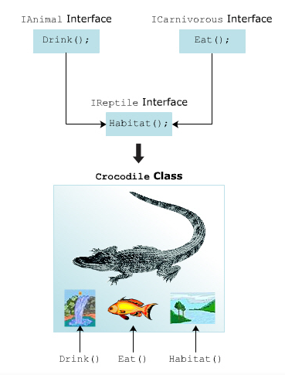
Interface Inheritance 2-5
The following figure displays an example of interface inheritance:

Slide 36
Interface Inheritance 3-5
The following syntax is used to inherit an interface:
where,
InterfaceName: Specifies the name of the interface that inherits another interface.
Inherited_InterfaceName: Specifies the name of the inherited interface.
Syntax
interface <InterfaceName> : <Inherited_InterfaceName>
{
// method declaration;
}

Slide 37
Interface Inheritance 4-5
The following code declares interfaces that are inherited by other interfaces:
Crocodile
Can stay in Water and Land
Eats Flesh
Drinks fresh water
interface IAnimal
{
void Drink();
}
interface ICarnivorous
{
void Eat();
}
interface IReptile : IAnimal, ICarnivorous
{
void Habitat();
}
class Crocodile : IReptile
{
public void Drink()
{
Console.WriteLine(“Drinks fresh water”);
}
public void Habitat()
{
Console.WriteLine(“Can stay in Water and Land”);
}
public void Eat()
{
Console.WriteLine(“Eats Flesh”);
}
static void Main(string[] args)
{
Crocodile objCrocodile = new Crocodile();
Console.WriteLine(objCrocodile.GetType().Name);
objCrocodile.Habitat();
objCrocodile.Eat();
objCrocodile.Drink();
}
}
Snippet
Output

Slide 38
Interface Inheritance 5-5
In the code:
Three interfaces, IAnimal, ICarnivorous, and IReptile, are declared.
The three interfaces declare methods Drink(), Eat(), and Habitat() respectively.
The IReptile interface inherits the IAnimal and ICarnivorous interfaces.
The class Crocodile implements the interface IReptile, its declared method Habitat() and the inherited methods Eat()and Drink() of the ICarnivorous and IAnimal interfaces.

Slide 39
Interface Re-implementation 1-2
A class can re-implement an interface.
Re-implementation occurs when the method declared in the interface is implemented in a class using the virtual keyword and this virtual method is then overridden in the derived class.
The following code demonstrates the purpose of re-implementation of an interface:
using System;
interface IMath {
void Area();
}
class Circle : IMath
{
public const float PI = 3.14F;
protected float Radius;
protected double AreaOfCircle;
public virtual void Area()
{
AreaOfCircle = (PI * Radius * Radius);
}
}
class Sphere : Circle
{
double _areaOfSphere;
public override void Area()
{
base.Area();
_areaOfSphere = (AreaOfCircle * 4 );
}
static void Main(string[] args)
{
Sphere objSphere = new Sphere();
objSphere.Radius = 7;
objSphere.Area();
Console.WriteLine("Area of Sphere: {0:F2}" ,
objSphere._areaOfSphere);
}
}
Snippet

Slide 40
Interface Re-implementation 2-2
In the code:
The interface IMath declares the method Area().
The class Circle implements the interface IMath.
The class Circle declares a virtual method Area()that calculates the area of a circle.
The class Sphere inherits the class Circle and overrides the base class method Area()to calculate the area of the sphere.
The base keyword calls the base class method Area(), thereby allowing the use of base class method in the derived class.
The following figure displays the output of re-implementation of an interface:

Slide 41
The is and as Operators in Interfaces 1-5
The is and as operators in C# when used with interfaces, verify whether the specified interface is implemented or not.
is Operator
Checks the compatibility between two types or classes and returns a boolean value based on the check operation performed.
as Operator
Returns null if the two types or classes are not compatible with each other.

Slide 42
The is and as Operators in Interfaces 2-5
The following code demonstrates an interface with the is operator:
using System;
interface ICalculate {
double Area();
}
class Rectangle : ICalculate{
float _length;
float _breadth;
public Rectangle(float valOne, float valTwo) {
_length = valOne;
_breadth = valTwo;
}
public double Area() {
return _length * _breadth;
}
static void Main(string[] args) {
Rectangle objRectangle = new Rectangle(10.2F, 20.3F);
if (objRectangle is ICalculate) {
Console.WriteLine("Area of rectangle: {0:F2}" , objRectangle.Area());
}
else {
Console.WriteLine("Interface method not implemented");
}
}
}
Snippet

Slide 43
The is and as Operators in Interfaces 3-5
In the code:
An interface ICalculate declares a method Area().
The class Rectangle implements the interface ICalculate and it consists of a parameterized constructor that assigns the dimension values of the rectangle.
The Area() method calculates the area of the rectangle. The Main() method creates an instance of the class Rectangle.
The is operator is used within the if-else construct to check whether the class Rectangle implements the methods declared in the interface ICalculate.
The following figure displays the output of the example using is operator:

Slide 44
The is and as Operators in Interfaces 4-5
The code demonstrates an interface with the as operator:
using System;
interface ISet
{
void AcceptDetails(int valOne, string valTwo);
}
interface IGet
{
void Display();
}
class Employee : ISet
{
int _empID;
string _empName;
public void AcceptDetails(int valOne, string valTwo)
{
_empID = valOne;
_empName = valTwo;
}
static void Main(string[] args)
{
Employee objEmployee = new Employee();
objEmployee.AcceptDetails(10, "Jack");
IGet objGet = objEmployee as IGet;
if (objGet != null)
{
objGet.Display();
}
else
{
Console.WriteLine("Invalid casting occurred");
}
}
}
Snippet

Slide 45
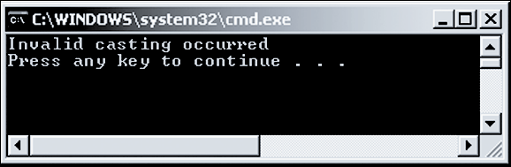
The is and as Operators in Interfaces 5-5
In the code:
The interface ISet declares a method AcceptDetails with two parameters and the interface IGet declares a method Display().
The class Employee implements the interface ISet and implements the method declared within ISet.
The Main()method creates an instance of the class Employee.
An attempt is made to retrieve an instance of IGet interface checks whether the class Employee implements the methods defined in the interface.
Since the as operator returns null, the code displays the specified error message.
The following figure displays the output of the example that uses the as operator:

Slide 46
Abstract Classes and Interfaces 1-2
Abstract classes and interfaces both declare methods without implementing them.
Although both abstract classes and interfaces share similar characteristics, they serve different purposes in a C# application.
The similarities between abstract classes and interfaces are as follows:
Neither an abstract class nor an interface can be instantiated.
Both, abstract classes as well as interfaces, contain abstract methods.
Abstract methods of both, the abstract class as well as the interface, are implemented by the inheriting subclass.
Both, abstract classes as well as interfaces, can inherit multiple interfaces.

Slide 47
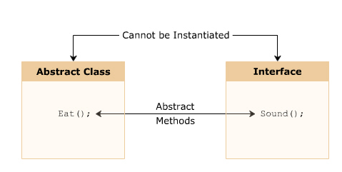
Abstract Classes and Interfaces 2-2
The following figure displays the similarities between abstract class and interface:

Slide 48
Differences Between an Abstract Class and an Interface
Abstract classes and interfaces are similar because both contain abstract methods that are implemented by the inheriting class.
However, there are certain differences between an abstract class and an interface as shown in the following table:
Abstract Classes | Interfaces
An abstract class can inherit a class and multiple interfaces. | An interface can inherit multiple interfaces but cannot inherit a class.
An abstract class can have methods with a body. | An interface cannot have methods with a body.
An abstract class method is implemented using the override keyword. | An interface method is implemented without using the override keyword.
An abstract class is a better option when you need to implement common methods and declare common abstract methods. | An interface is a better option when you need to declare only abstract methods.
An abstract class can declare constructors and destructors. | An interface cannot declare constructors or destructors.

Slide 49
Recommendations for Using Abstract Classes and Interfaces
An abstract class can inherit another class whereas an interface cannot inherit a class.
Therefore, abstract classes and interfaces have certain similarities as well as certain differences.
Following are the guidelines to decide when to use an interface and when to use an abstract class:
If a programmer wants to create reusable programs and maintain multiple versions of these programs, it is recommended to create an abstract class.
Abstract classes helps to maintain the version of the programs in a simple manner.
Unlike abstract classes, interfaces cannot be changed once they are created.
A new interface needs to be created to create a new version of the existing interface.
Interface
If a programmer wants to create different methods that are useful for different types of objects, it is recommended to create an interface.
There must exist a relationship between the abstract class and the classes that inherit the abstract class.
On the other hand, interfaces are suitable for implementing similar functionalities in dissimilar classes.
Abstract class

Slide 50
Summary
An abstract class can be referred to as an incomplete base class and can implement methods that are similar for all the subclasses.
IntelliSense provides access to member variables, functions, and methods of an object or a class.
When implementing an interface in a class, you need to implement all the abstract methods declared in the interface.
A class implementing multiple interfaces has to implement all abstract methods declared in the interfaces.
A class has to explicitly implement multiple interfaces if these interfaces have methods with identical names.
Re-implementation occurs when the method declared in the interface is implemented in a class using the virtual keyword and this virtual method is then overridden in the derived class.
The is operator is used to check the compatibility between two types or classes and as operator returns null if the two types or classes are not compatible with each other.

Slide 51

THANKS FOR WATCHING !

